Slide 1
Central Texas Market
Area of Responsibility
TPR & Absent Sick

Slide 2
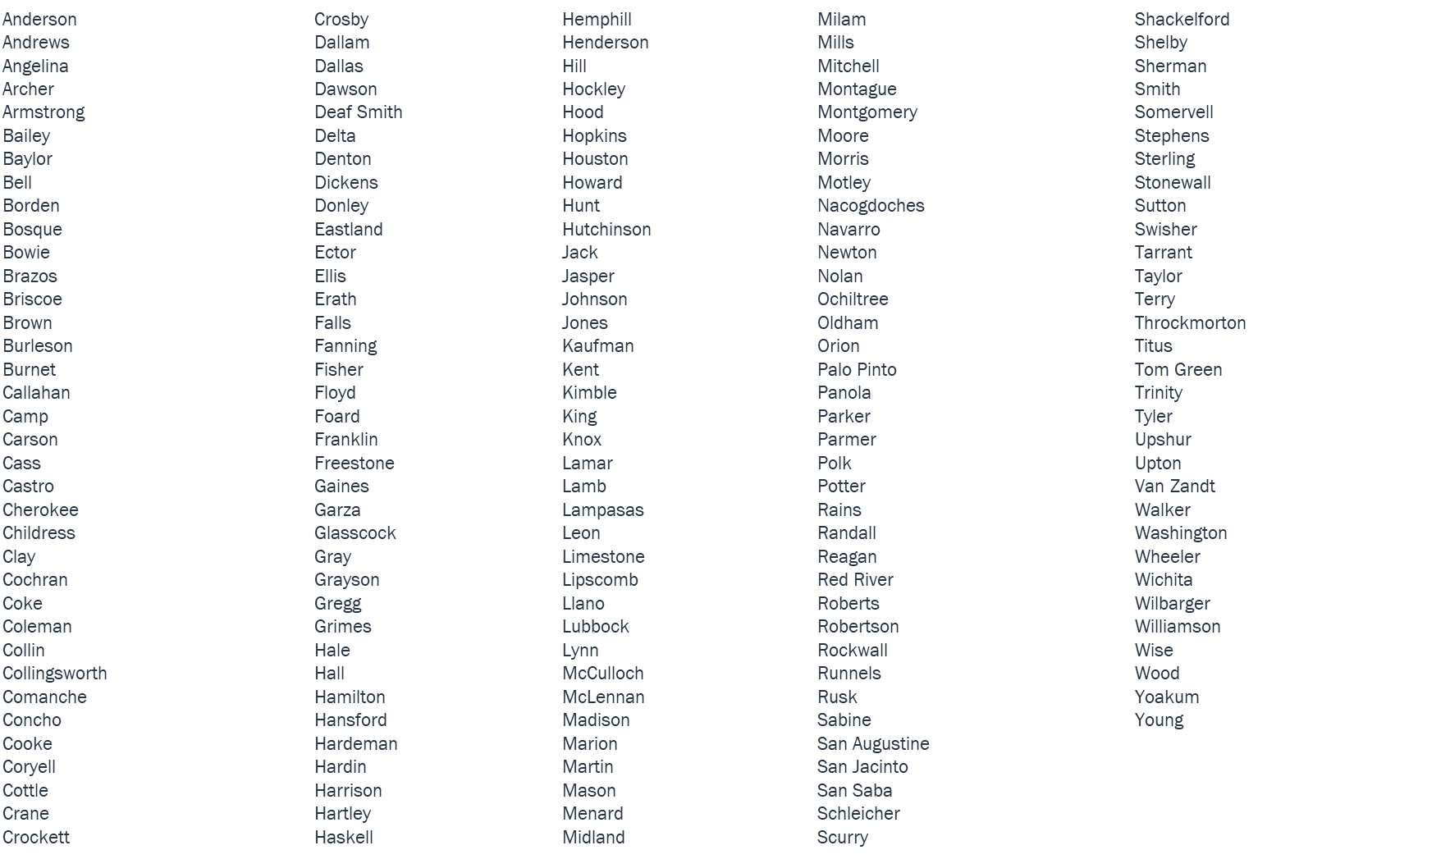
Texas Counties

Slide 3
